Slide 1
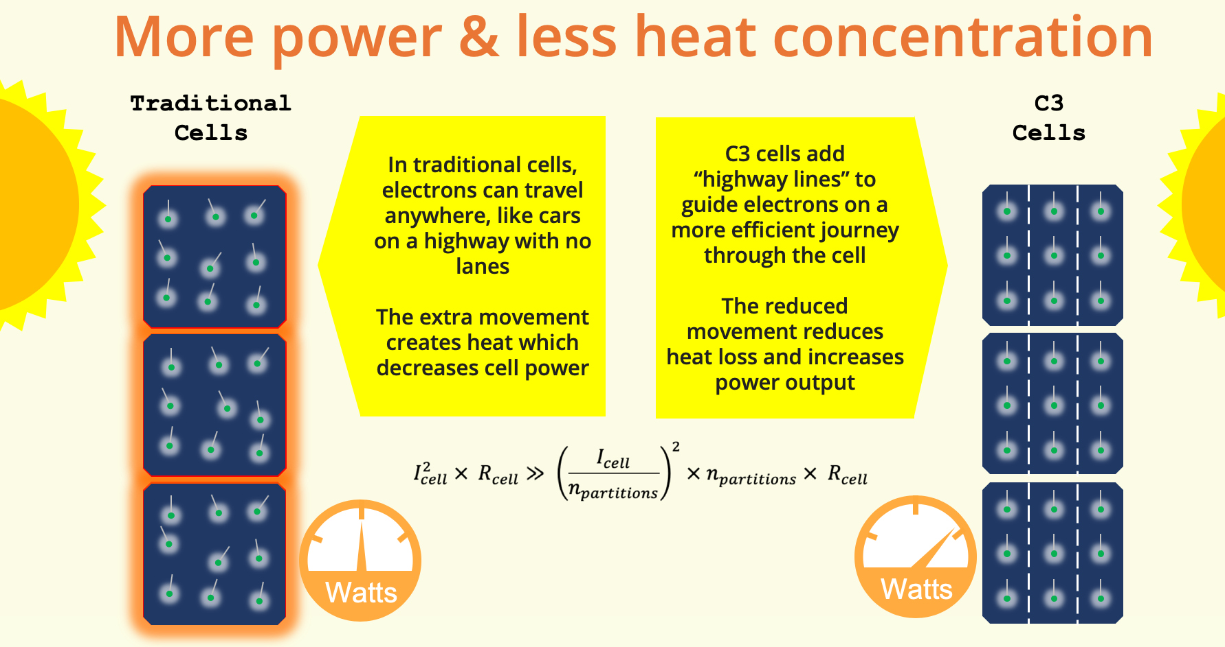
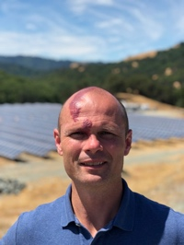
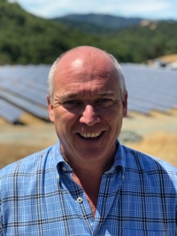
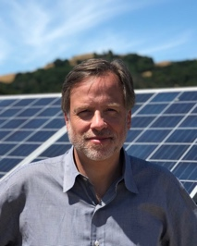
Solar Inventions C3: ultra-low-cost gains in PV module energy & safety
C3 Benefits:
2-3 watt increase per panel
3-5% savings on silver costs
Works with and improves BSF, PERC, HJT, bi-facial, half-cell, larger wafers
Manufacturable on virtually all existing cell and module lines
The Configurable Current Cell (C3) is the result of years of research by Dr. Damiani in the core physics of silicon solar cells. The American-Made Solar Prize has been invaluable in helping commercialize this U.S. innovation. Development continues on our next product, the Configurable Voltage Cell (CVC).
Dr. Ben Damiani
EE PhD from Georgia Tech
Studied at Fraunhofer
Created first ion implanted Suniva products
Worked at Intel, SolarWorld
30 papers and multiple patents
Gregg Freishtat
30 years founding and building startups, including 5 exits
Holds 18 patents
JD/Law degree from Univ of Maryland
Bill Nussey
25 year tech CEO
Multiple exits including IPO
Author of Freeing Energy
Greylock VC; IBM VP Corp Strategy
EE from NCSU
MBA from HBS

